Slide 1
Python Parallel Singular Value Decomposition
Viacheslav Naumov
Danil Gusak

Slide 2
Python Parallel Singular Value Decomposition
Viacheslav Naumov
Danil Gusak

Slide 3
Conway's Game of Life with MPI
Viacheslav Naumov
Danil Gusak

Slide 4
Main Idea
At each step in time, the following transitions occur:
Any live cell with two or three live neighbours survives.
Any dead cell with three live neighbours becomes a live cell.
All other live cells die in the next generation. Similarly, all other dead cells stay dead.

Slide 5
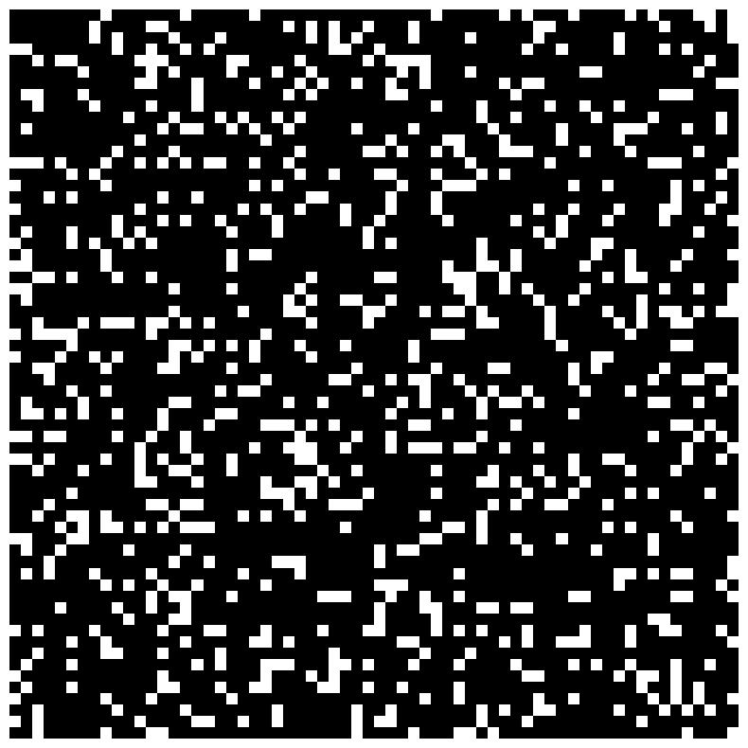
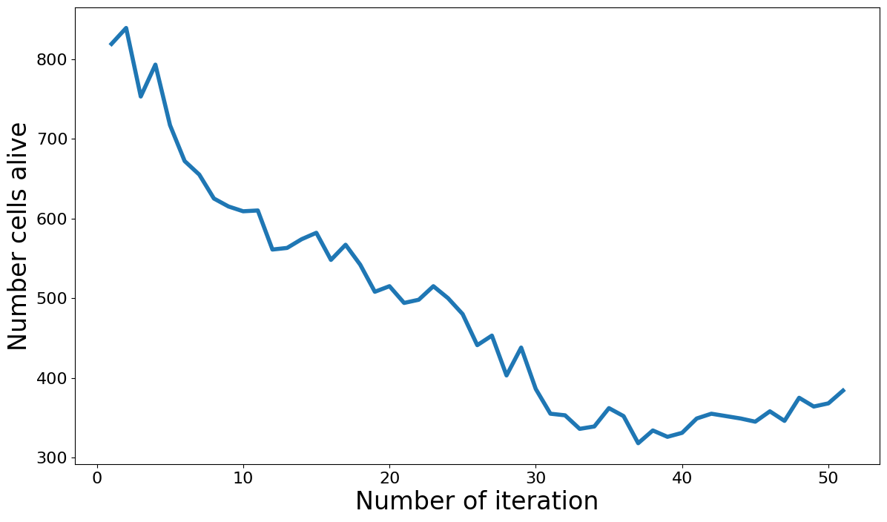
Random initial condition

Slide 6
Parallel version
Generate part of the initial conditions on each process
Define local variables
Each process should send first row to previous process and last row next process
Collect result from processes

Slide 7
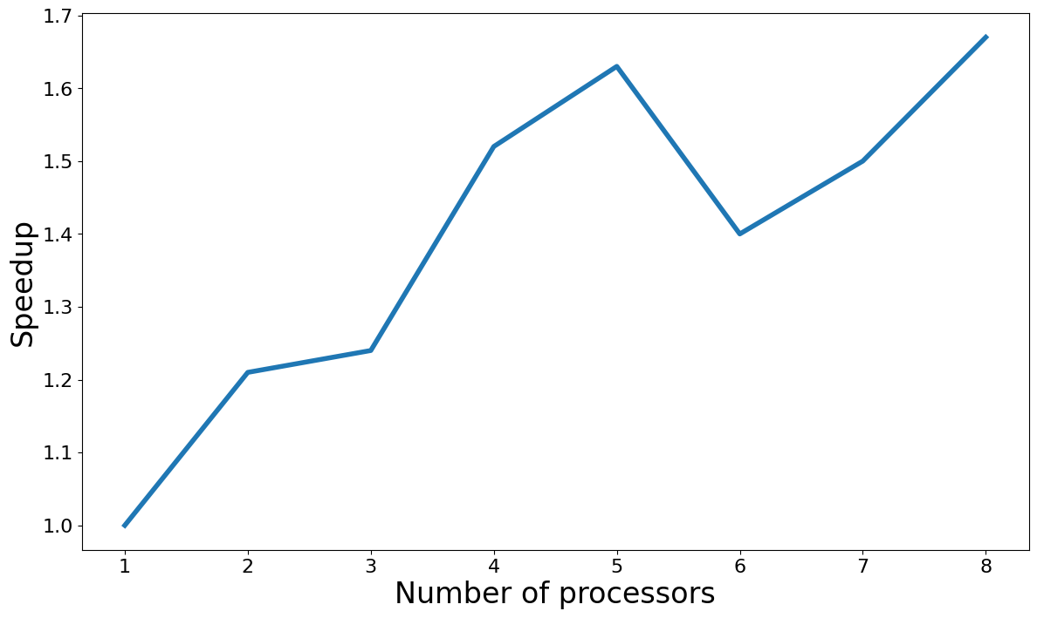
Random initial condition

Slide 8
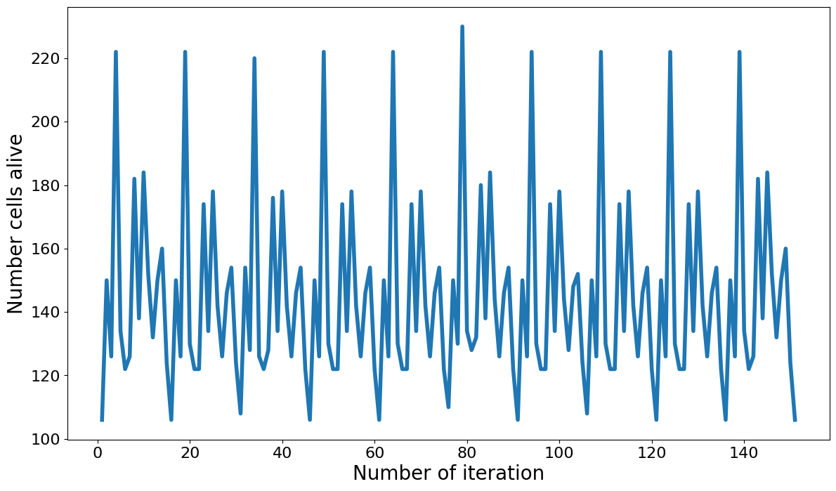
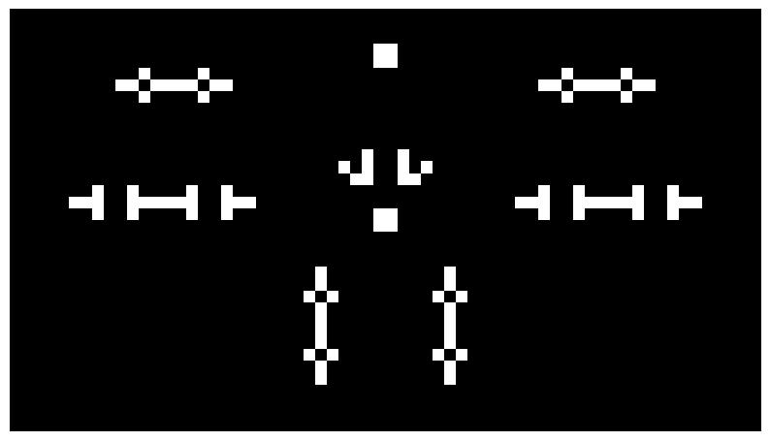
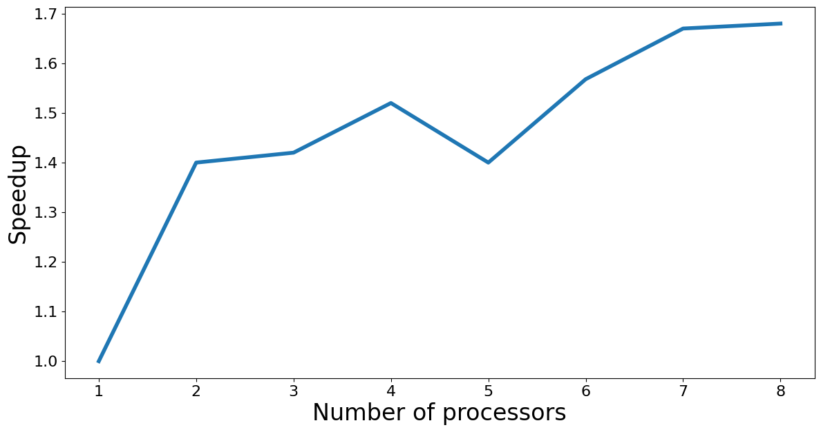
106P135

Slide 9
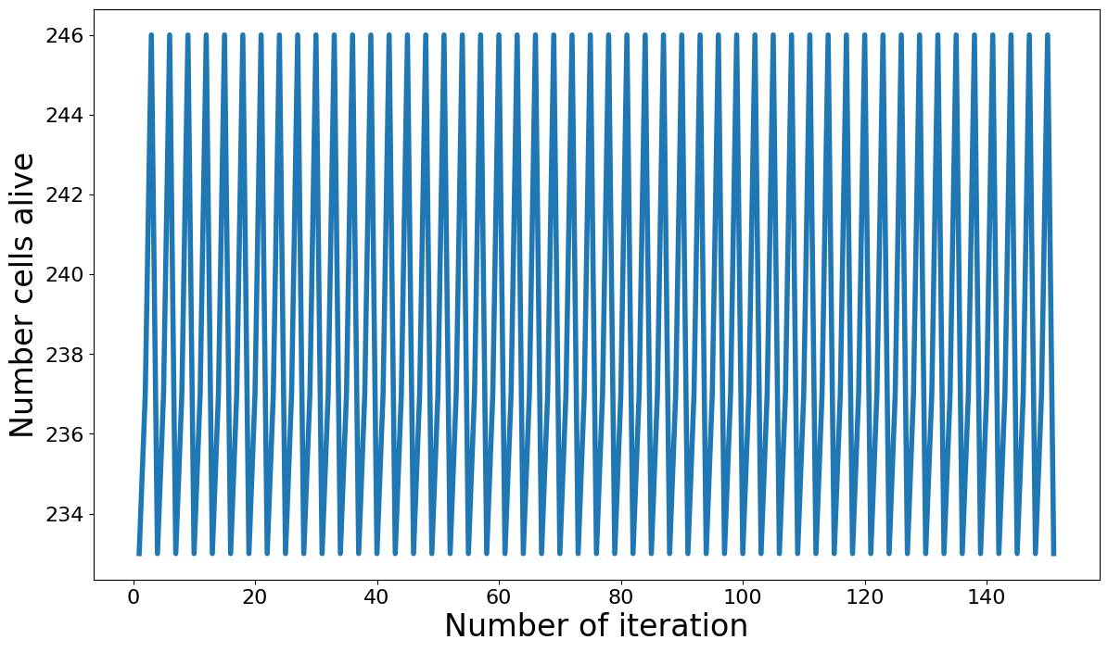
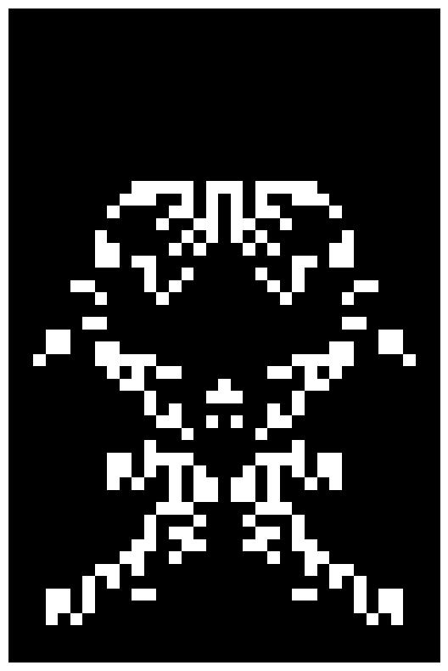
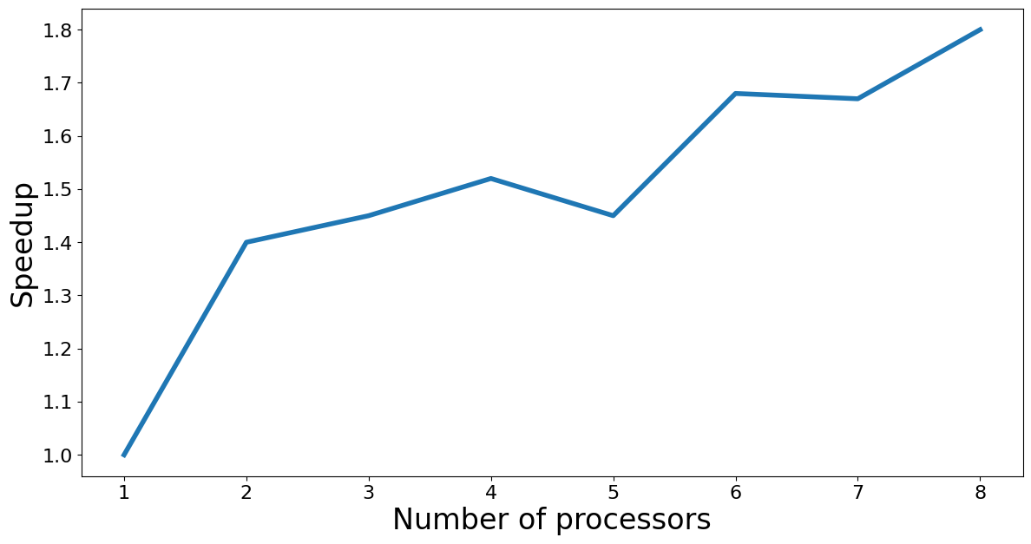
Spaceship

Slide 10
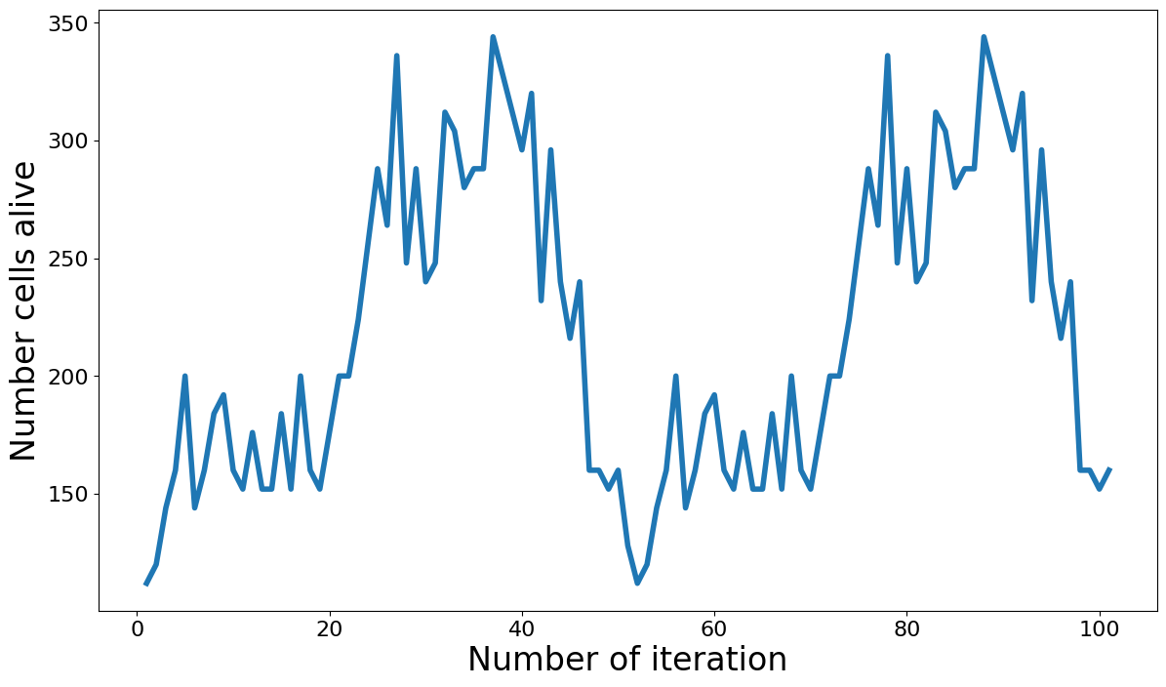
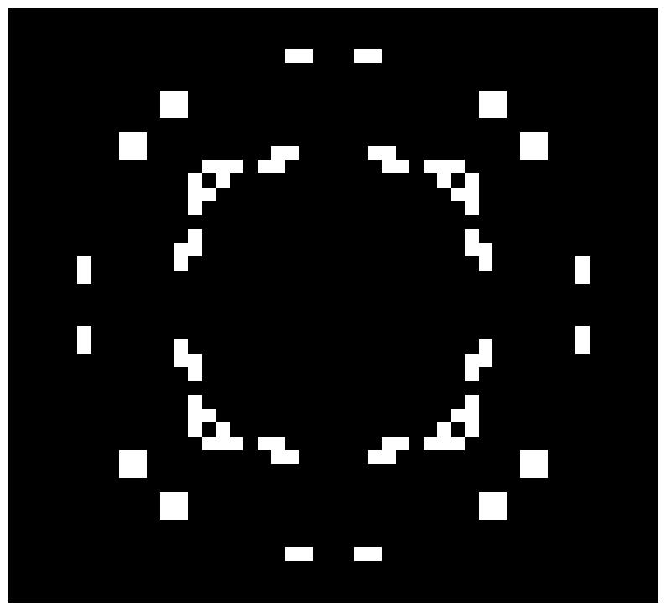
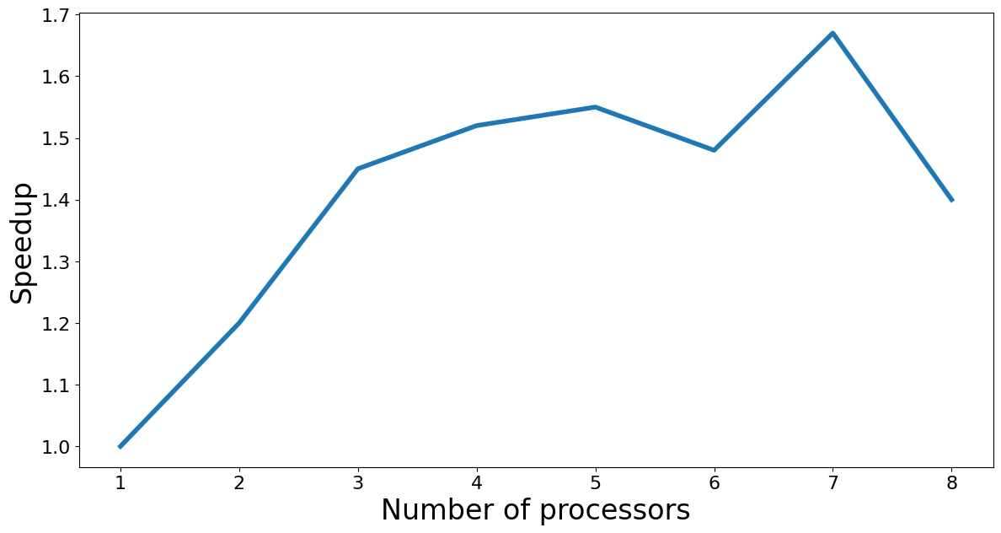
112P51

Slide 11
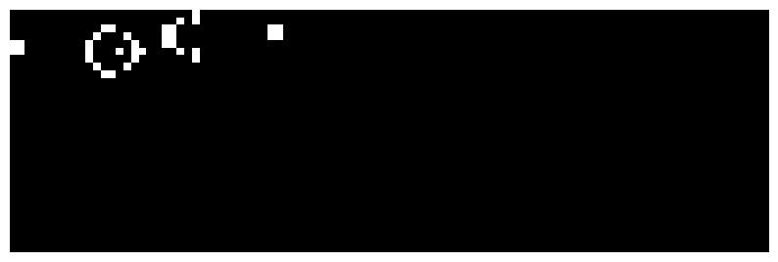
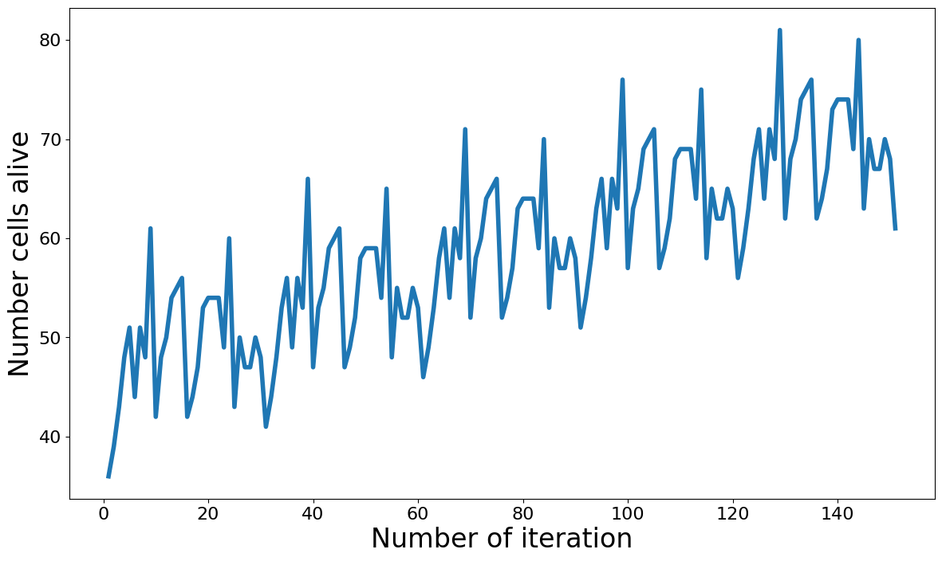
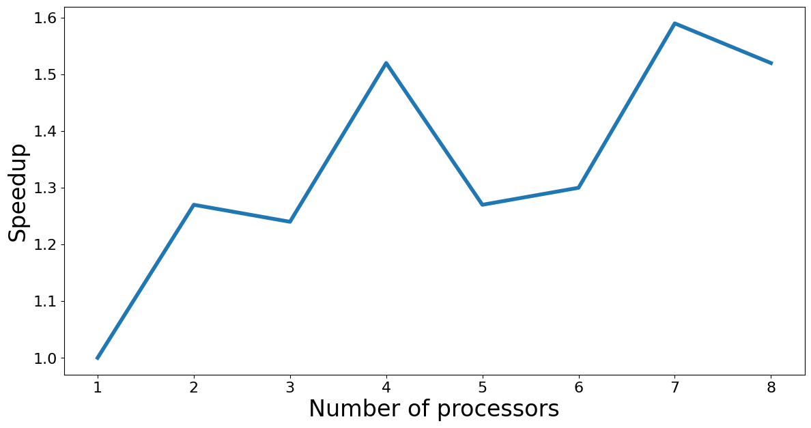
Glider
gun

Slide 12
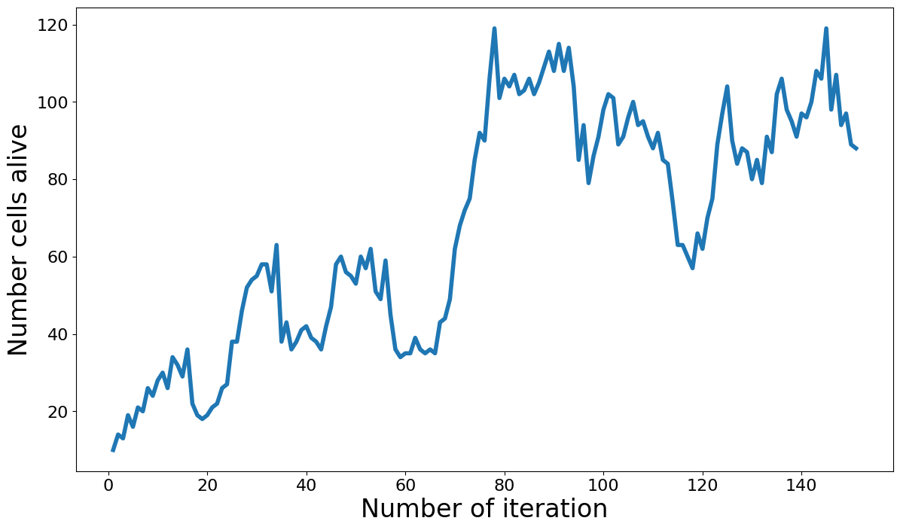
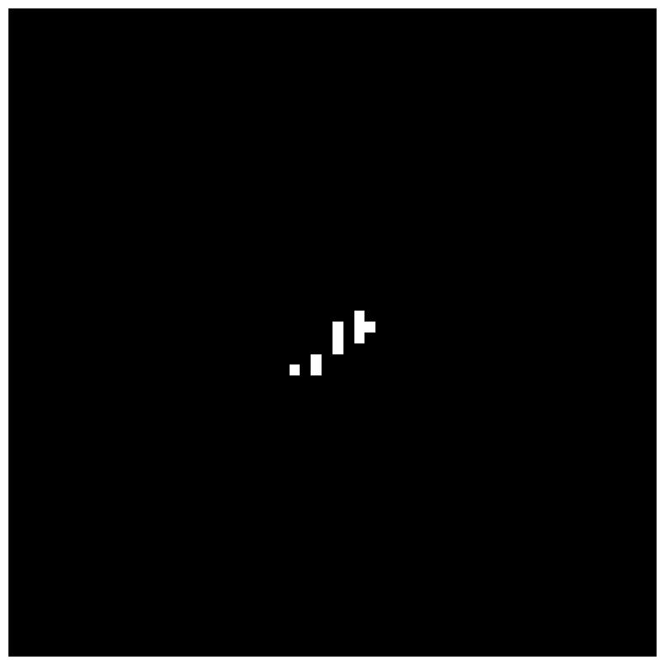
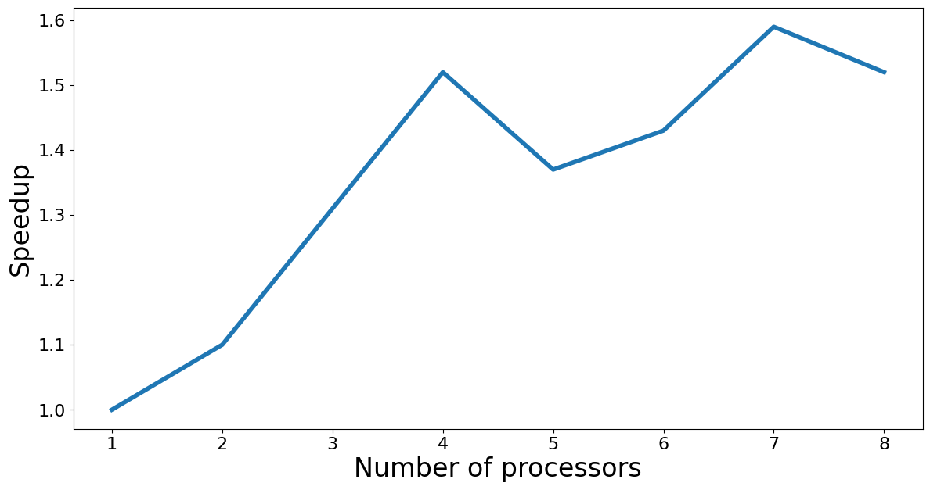
Infinite growth

Slide 13
Conclusion
Implemented Conway's Game of Life
The number of living cells was analyzed for various initial conditions
Implemented parallel version of algorithm
Obtained speed up for different initial conditions

